Slide 1
SQ Project Outline
Tim Hebestreit and Hao Tran

Slide 2
Preparation
Create GitHub repository (https://github.com/haotrn/sq-templates)
Task allocation: Hao Java, Tim Python
Familiarize with CookieCutter
Revise relevant lectures
Research existing implementations of similar templates (https://www.cookiecutter.io/templates)
Create project plan & Gantt chart
Create outline presentation

Slide 3
Templates
Based on SQ aspects of lecture
Version control
Sharable state
Documentation
Licensing and Citation
Include automatization
Research and compare with existing implementations of similar templates

Slide 4
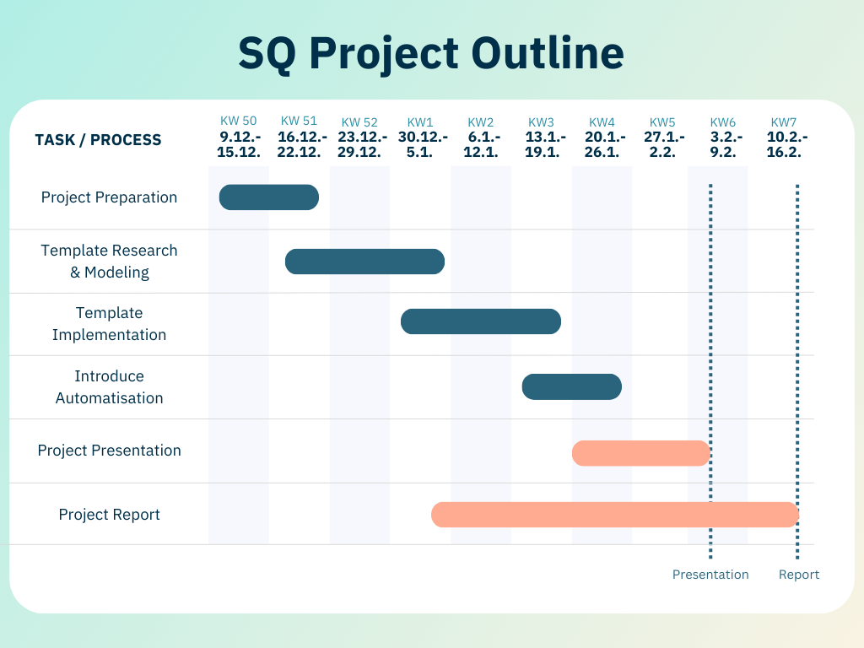
Notes:
Chart link: https://www.canva.com/design/DAGZX5lXEp4/E95neYW7Pp9xB8G-vxZkTg/edit?utm_content=DAGZX5lXEp4&utm_campaign=designshare&utm_medium=link2&utm_source=sharebutton

Slide 5
Project plan
KW 50 (9.12.-15.12.): Project Preparation: Familiarize with Cookiecutter, Revise Lectures, Allocate Tasks, Prepare Outline
KW 51 (16.12.-22.12.): Present Outline, Template Research & Modeling
KW 52 (23.12.-29.12.): Template Research & Modeling
KW 1 (30.12.-5.1.): Template Implementation, Start working on Report
KW 2 (6.1.-12.1.): Template Implementation
KW 3 (13.1.-19.1.): Template Implementation, Introduce Automatisation, Add Details
KW 4 (20.1.-26.1.): Introduce Automatisation, Add Details, Create Presentation
KW 5 (27.1.-2.2.): Finish Presentation, Finish Report
KW 6 (3.2.-9.2.): Present Project, Buffer
KW 7 (10.2.-16.2.): Submit Report

